Slide 1
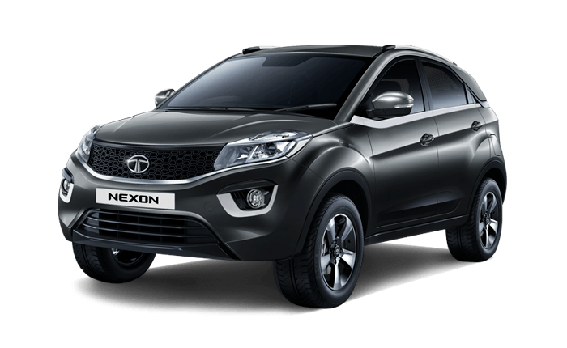


TATA Nexon
The Tata Nexon is a subcompact crossover SUV produced by the Indian automaker Tata Motors since 2017. It holds the distinction of being the first crossover SUV from the Tata brand and occupies the sub-4-meter crossover SUV segment in India

Slide 2
Nexon Creative Plus DT AMT
The Tata Nexon is a subcompact crossover SUV produced by the Indian automaker Tata Motors since 2017. It holds the distinction of being the first crossover SUV from the Tata brand and occupies the sub-4-meter crossover SUV segment in India
Design:
The new Nexon boasts an aggressive SUV style with its raised hood, sleek lamps, and dynamic stance. The signature X factor of the Nexon has taken on a futuristic appeal. The sequential LED DRLs enhance visibility during daytime hours, while the 2-spoke steering wheel with an illuminated logo adds a touch of elegance. The Nexon is truly a head-turne
Safety:
The Tata Nexon prioritizes safety. It has achieved a 5-star rating from the Global NCAP (GNCAP), making it the safest car on Indian roads. With features like 6 airbags, electronic stability program, and a fortified cabin, the Nexon ensures a secure drive for you and your loved
Performance:
The Nexon outperforms its competition with turbocharged petrol and diesel engines. The 7-speed DCA transmission provides refined ergonomics.
The engine options include 1.2L Turbocharged Revotron Petrol with class-leading 120PS (88.2 kW) power.
1.5L Turbocharged Revotorq Diesel with class-leading 115PS (84.5 kW) power
Technology:
The Nexon embraces futuristic tech, including:
A 10.25-inch infotainment system by Harman.
A 10.25-inch digital instrument cluster.
Connected Vehicle technology with IRA 2.0.

Slide 3
TATA Nexon
The Tata Nexon is a subcompact crossover SUV produced by the Indian automaker Tata Motors since 2017. It holds the distinction of being the first crossover SUV from the Tata brand and occupies the sub-4-meter crossover SUV segment in India
118.27 HP
Maximum Power
17.18 Kmpl
Mileage (upto)
180 kmph
Top Speed
Design:
The new Nexon boasts an aggressive SUV style with its raised hood, sleek lamps, and dynamic stance. The signature X factor of the Nexon has taken on a futuristic appeal. The sequential LED DRLs enhance visibility during daytime hours, while the 2-spoke steering wheel with an illuminated logo adds a touch of elegance. The Nexon is truly a head-turne
Safety:
The Tata Nexon prioritizes safety. It has achieved a 5-star rating from the Global NCAP (GNCAP), making it the safest car on Indian roads. With features like 6 airbags, electronic stability program, and a fortified cabin, the Nexon ensures a secure drive for you and your loved
Performance:
The Nexon outperforms its competition with turbocharged petrol and diesel engines. The 7-speed DCA transmission provides refined ergonomics.
The engine options include 1.2L Turbocharged Revotron Petrol with class-leading 120PS (88.2 kW) power.
1.5L Turbocharged Revotorq Diesel with class-leading 115PS (84.5 kW) power
Technology:
The Nexon embraces futuristic tech, including:
A 10.25-inch infotainment system by Harman.
A 10.25-inch digital instrument cluster.
Connected Vehicle technology with IRA 2.0.

Slide 4
TATA Nexon
The Tata Nexon is a subcompact crossover SUV produced by the Indian automaker Tata Motors since 2017. It holds the distinction of being the first crossover SUV from the Tata brand and occupies the sub-4-meter crossover SUV segment in India
Design:
The new Nexon boasts an aggressive SUV style with its raised hood, sleek lamps, and dynamic stance. The signature X factor of the Nexon has taken on a futuristic appeal. The sequential LED DRLs enhance visibility during daytime hours, while the 2-spoke steering wheel with an illuminated logo adds a touch of elegance. The Nexon is truly a head-turne
118.27 HP
Maximum Power
Safety:
The Tata Nexon prioritizes safety. It has achieved a 5-star rating from the Global NCAP (GNCAP), making it the safest car on Indian roads. With features like 6 airbags, electronic stability program, and a fortified cabin, the Nexon ensures a secure drive for you and your loved
17.18 Kmpl
Mileage (upto)
Performance:
The Nexon outperforms its competition with turbocharged petrol and diesel engines. The 7-speed DCA transmission provides refined ergonomics.
The engine options include 1.2L Turbocharged Revotron Petrol with class-leading 120PS (88.2 kW) power.
1.5L Turbocharged Revotorq Diesel with class-leading 115PS (84.5 kW) power
Nexon Creative Plus DT AMT
180 kmph
Top Speed
Technology:
The Nexon embraces futuristic tech, including:
A 10.25-inch infotainment system by Harman.
A 10.25-inch digital instrument cluster.
Connected Vehicle technology with IRA 2.0.

Slide 5
Nexon Creative Plus DT AMT

